Slide 1
Metal 3D Printer
Nathan Krikawa, Nolan Hann

Slide 2
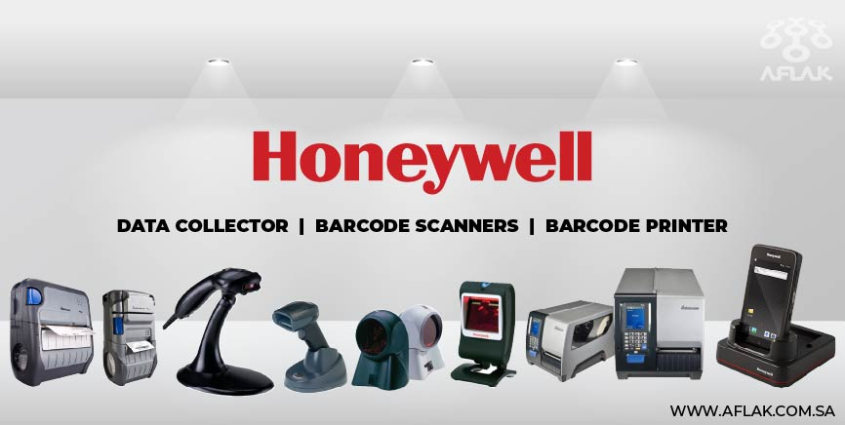
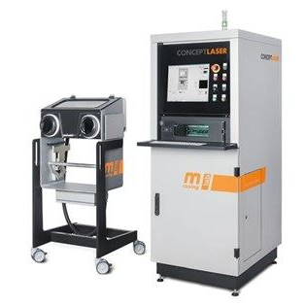
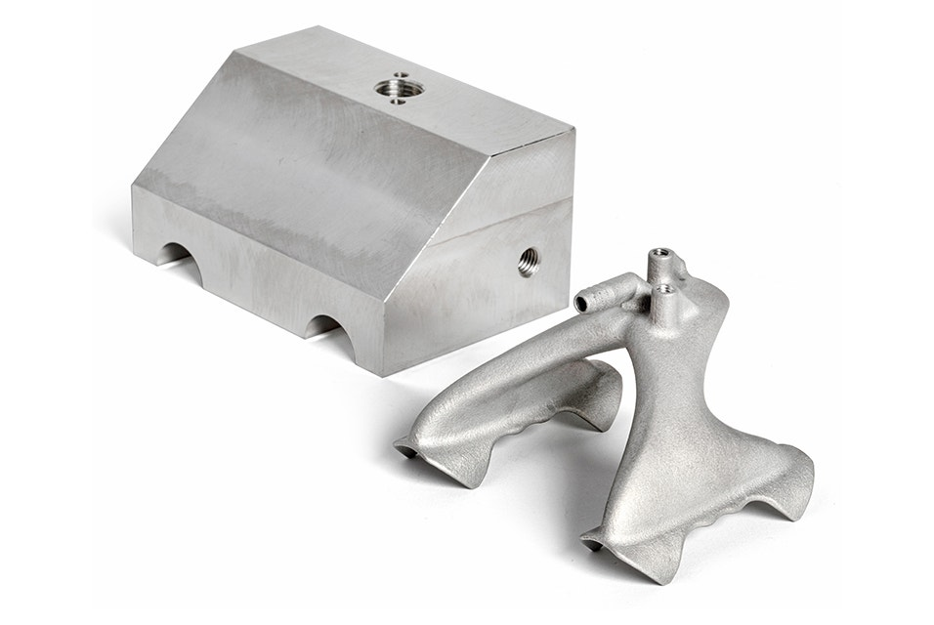
Project Description
Overview:
Commissioning of Concept Laser Mlab Cusing R metal 3D printer
Donated by Honeywell to NAU’s ME department for the IDEA Lab
Our Job:
Install and restore printer to proper functionality.
Evaluate printed specimen against machined counterparts
Print final part as part of assembly using topology optimization
Create instruction manual for training purposes in preparation for work orders and ME286L curriculum expansion
Figure 2: Honeywell logo and products
Figure 1: Concept Laser Mlab Cusing R
Figure 3: Redesigned aluminum gripper
Notes:
Overview:
Installing and Troubleshooting a M100LabR Concept Laser PBF Printer
Printing and evaluating parts and specimens (ie Stress-Strain, Thermal Management)
Creation of a user manual and short curriculum for ME286L
Included is the printer itself, powder mixer, powder trolley, and various powdered alloys for use with the printer
Location of set-up: CEIAS IDEA Lab, Room 116A

Slide 3
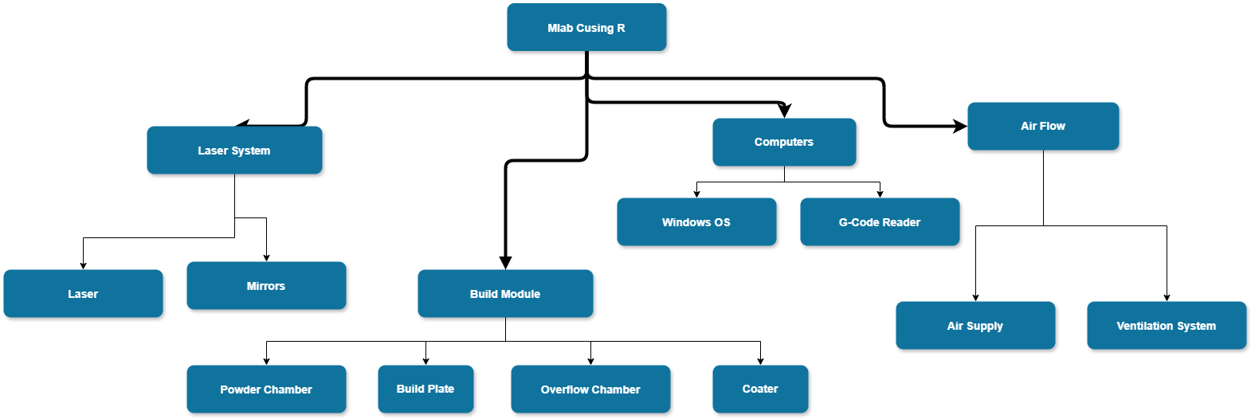
Physical Decomposition
Notes:
Overview:
Installing and Troubleshooting a M100LabR Concept Laser PBF Printer
Printing and evaluating parts and specimens (ie Stress-Strain, Thermal Management)
Creation of a user manual and short curriculum for ME286L
Included is the printer itself, powder mixer, powder trolley, and various powdered alloys for use with the printer
Location of set-up: CEIAS IDEA Lab, Room 116A

Slide 4
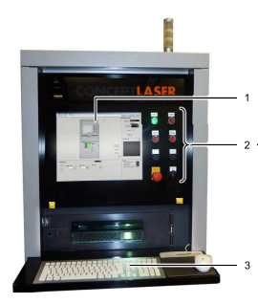
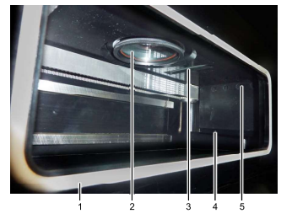
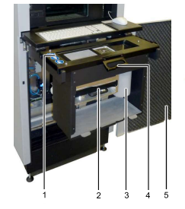
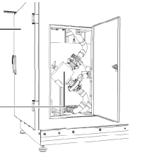
Physical Decomposition Cont.
Figure 5: Build Module
Figure 7: Condensate Filter
Figure 6: Build Chamber
Figure 4: Machine Computer
Notes:
Overview:
Installing and Troubleshooting a M100LabR Concept Laser PBF Printer
Printing and evaluating parts and specimens (ie Stress-Strain, Thermal Management)
Creation of a user manual and short curriculum for ME286L
Included is the printer itself, powder mixer, powder trolley, and various powdered alloys for use with the printer
Location of set-up: CEIAS IDEA Lab, Room 116A

Slide 5
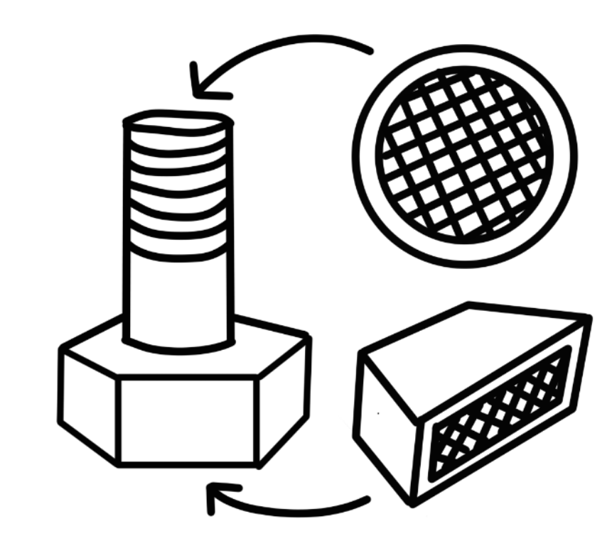
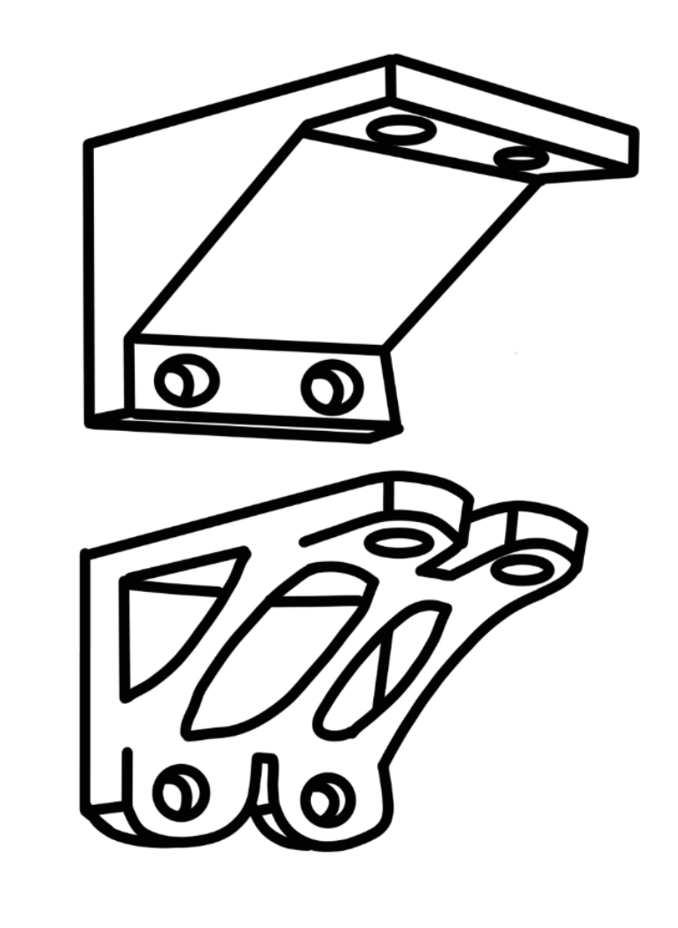
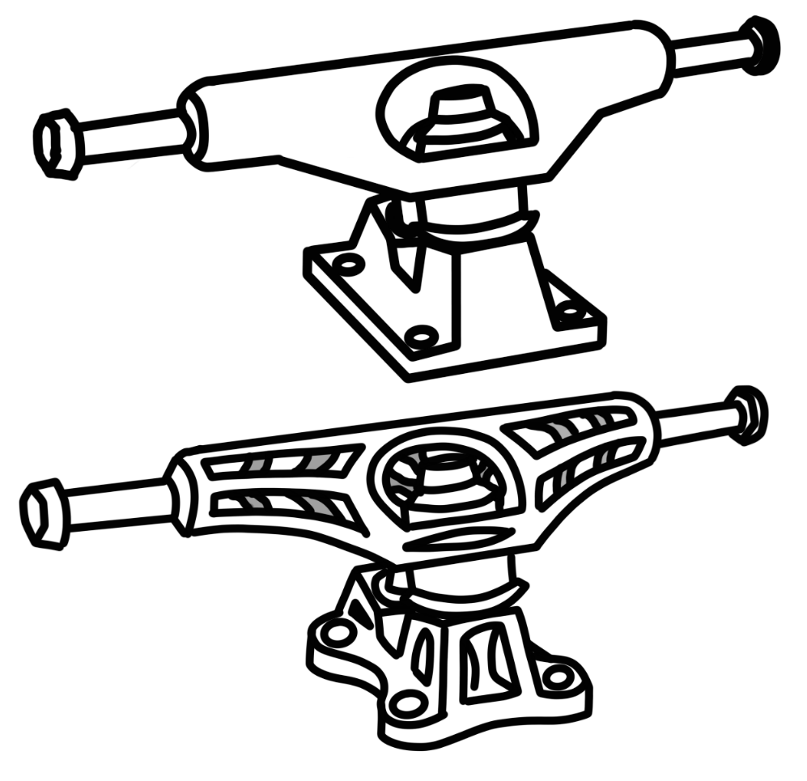
Concept Gen. - Final Part
Requirements:
Part of assembly
Benefits from topology optimization (weight reduction)
Difficult or impossible to machine
Concepts:
Fastener (bolt, screw, etc.)
Bracket
Larger component scaled down
Figure 8: Fastener with Lattice Structure
Figure 10: Skateboard Truck with Optimized Topology
Figure 9: Bracket with Optimized Topology
Notes:
Overview:
Installing and Troubleshooting a M100LabR Concept Laser PBF Printer
Printing and evaluating parts and specimens (ie Stress-Strain, Thermal Management)
Creation of a user manual and short curriculum for ME286L
Included is the printer itself, powder mixer, powder trolley, and various powdered alloys for use with the printer
Location of set-up: CEIAS IDEA Lab, Room 116A

Slide 6
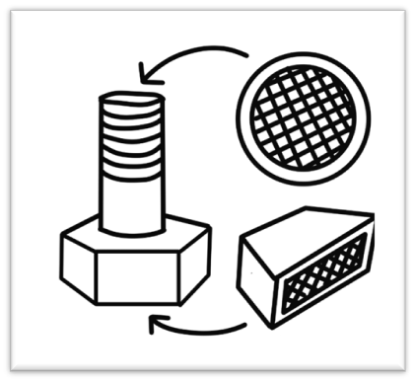
Concept Gen. - Final Part Cont.
Fastener
Bracket
Skateboard Truck
Pros | Cons
Simple assembly | Low tolerance
New to industry | Not visually impactful
Useful at scale | Only lattice
Pros | Cons
Simple assembly | Industry standard
High tolerance | Only topology optimization
Useful at scale | More useful at larger scales
Pros | Cons
Topology and lattice viable | More useful at larger scales
Visually impactful | Involved assembly
New to industry | Complicated geometry
Notes:
Overview:
Installing and Troubleshooting a M100LabR Concept Laser PBF Printer
Printing and evaluating parts and specimens (ie Stress-Strain, Thermal Management)
Creation of a user manual and short curriculum for ME286L
Included is the printer itself, powder mixer, powder trolley, and various powdered alloys for use with the printer
Location of set-up: CEIAS IDEA Lab, Room 116A

Slide 7
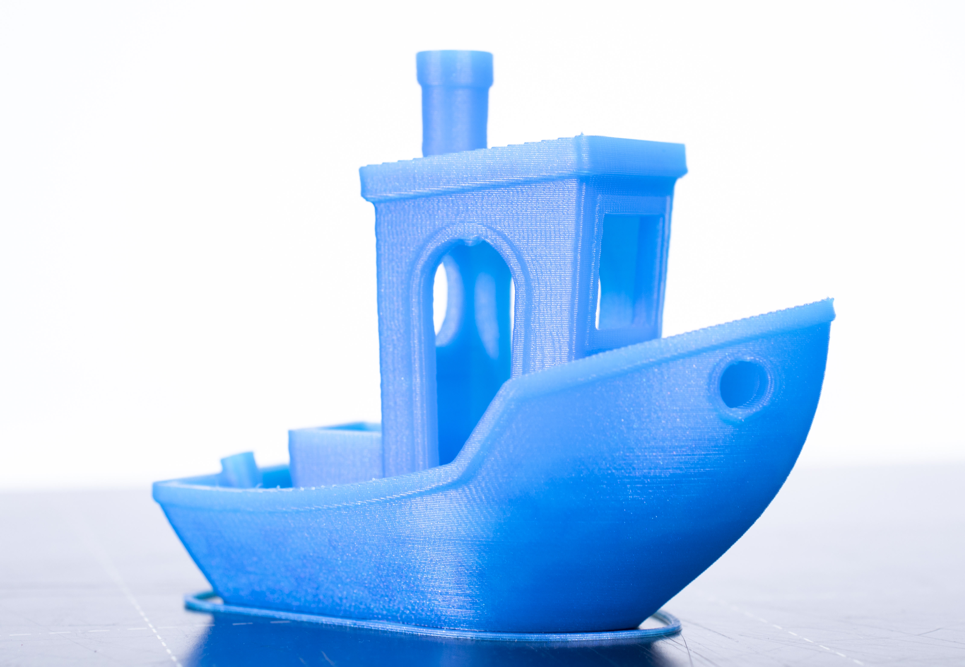
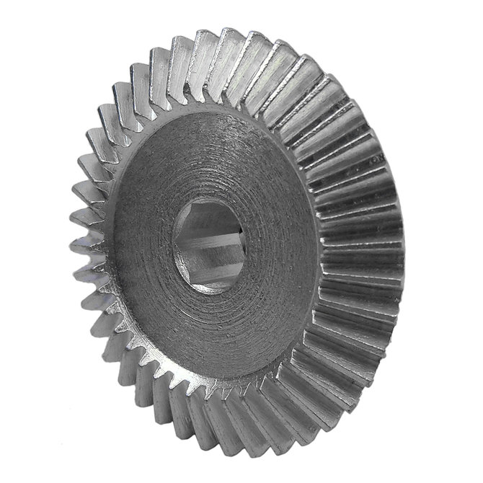
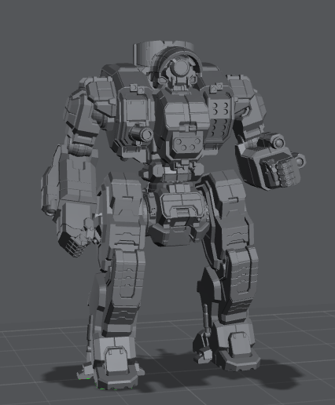
Concept Gen. - Test Print
Rationale:
Testing the printer for any layer/build issues
Practicing procedure
Concepts:
Benchy
Miniature
Gear
Figure 11: Benchy
Figure 12: Bevel Gear
Figure 13: Miniature
Notes:
Overview:
Installing and Troubleshooting a M100LabR Concept Laser PBF Printer
Printing and evaluating parts and specimens (ie Stress-Strain, Thermal Management)
Creation of a user manual and short curriculum for ME286L
Included is the printer itself, powder mixer, powder trolley, and various powdered alloys for use with the printer
Location of set-up: CEIAS IDEA Lab, Room 116A

Slide 8
Concept Gen. - Test Print Cont.
Benchy
Miniature
Gear
Pros | Cons
Ubiquitous | Size
Easy to spot layer defects | Can be printed on most machines
Good Sample
Pros | Cons
Complex Part | Easy Failure
Good Demonstration of the Machine | Potential waste of powder
Pros | Cons
Complex Part | Can be molded easily
Tolerance Testing | Very high tolerance
Extra Credit for ME465
Notes:
Overview:
Installing and Troubleshooting a M100LabR Concept Laser PBF Printer
Printing and evaluating parts and specimens (ie Stress-Strain, Thermal Management)
Creation of a user manual and short curriculum for ME286L
Included is the printer itself, powder mixer, powder trolley, and various powdered alloys for use with the printer
Location of set-up: CEIAS IDEA Lab, Room 116A

Slide 9
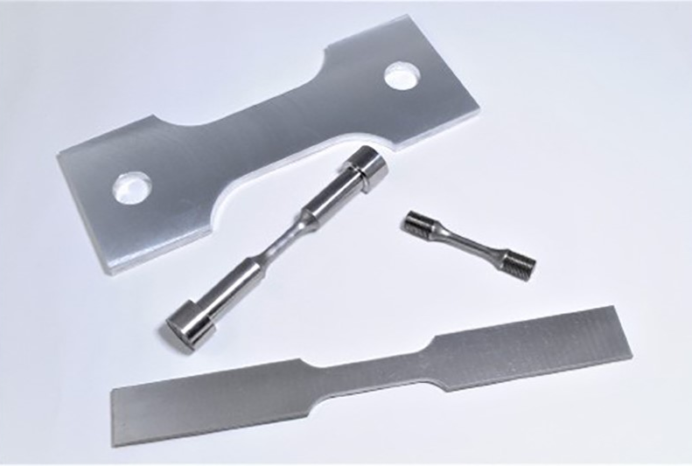
Concept Gen. - Test Specimen
Dogbone
Cylindrical
Rectangular
Three Different Samples
Machined
Printed Stock, Machined
As Printed
Figure 14: Dogbone Specimens
Notes:
Overview:
Installing and Troubleshooting a M100LabR Concept Laser PBF Printer
Printing and evaluating parts and specimens (ie Stress-Strain, Thermal Management)
Creation of a user manual and short curriculum for ME286L
Included is the printer itself, powder mixer, powder trolley, and various powdered alloys for use with the printer
Location of set-up: CEIAS IDEA Lab, Room 116A

Slide 10
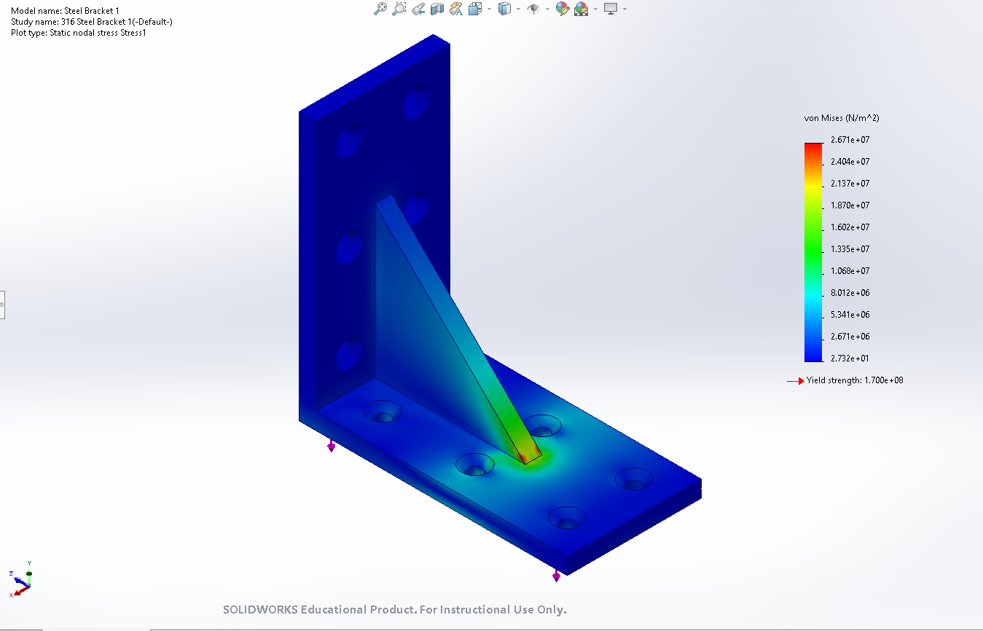
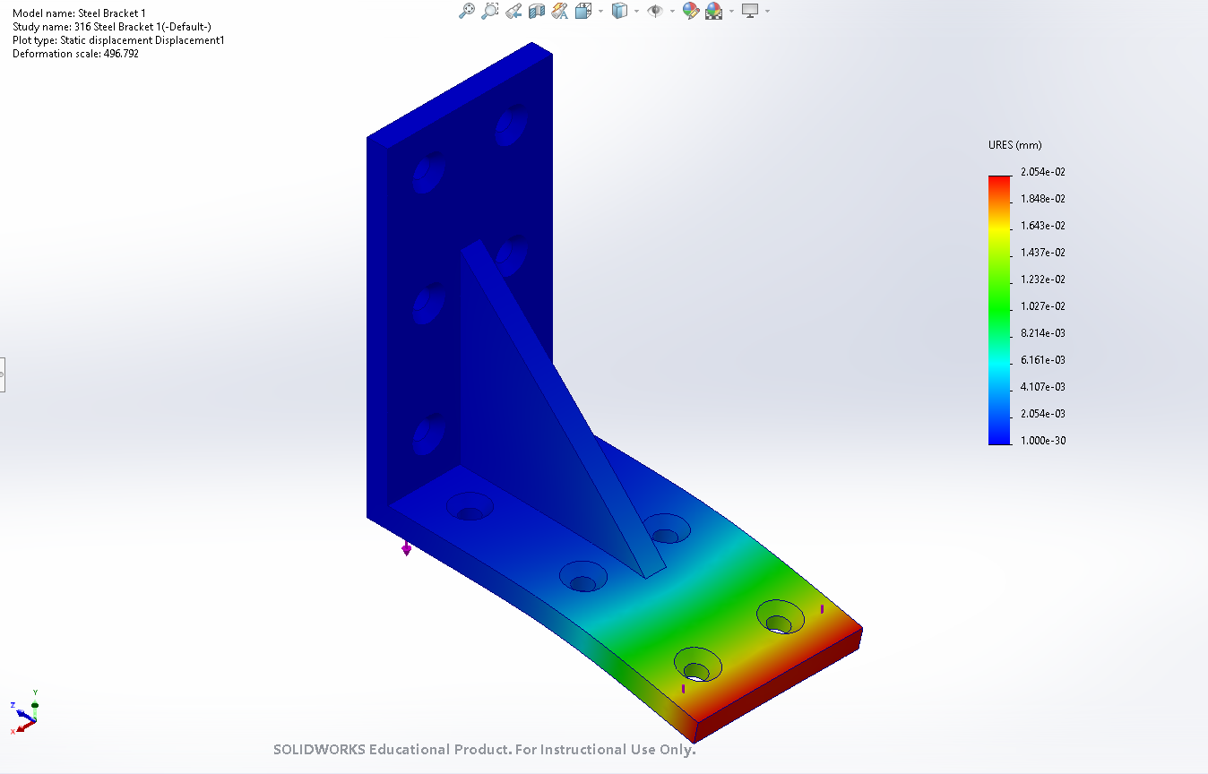
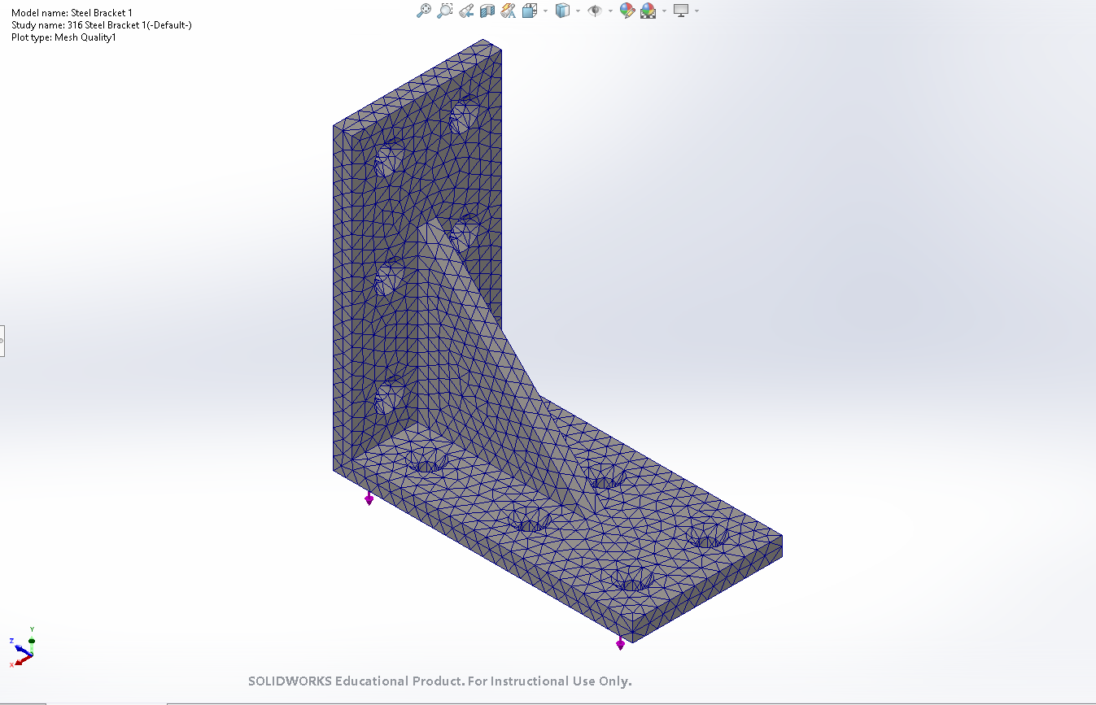
Engineering Calc. FEA Bracket
Figure 16: FEA Results - Displacement
Figure 15: FEA Results - Stress
Figure 17: FEA Results – Generated Mesh
Notes:
Overview:
Installing and Troubleshooting a M100LabR Concept Laser PBF Printer
Printing and evaluating parts and specimens (ie Stress-Strain, Thermal Management)
Creation of a user manual and short curriculum for ME286L
Included is the printer itself, powder mixer, powder trolley, and various powdered alloys for use with the printer
Location of set-up: CEIAS IDEA Lab, Room 116A

Slide 11
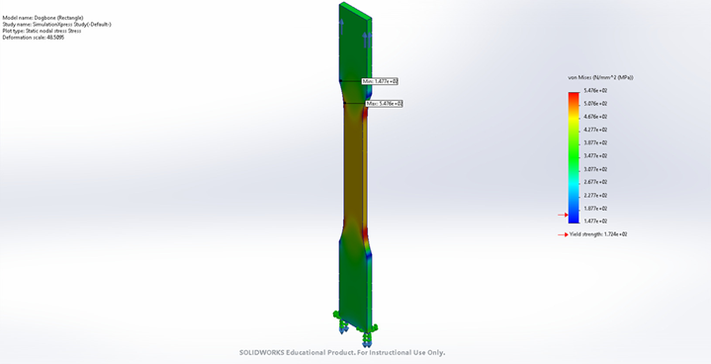
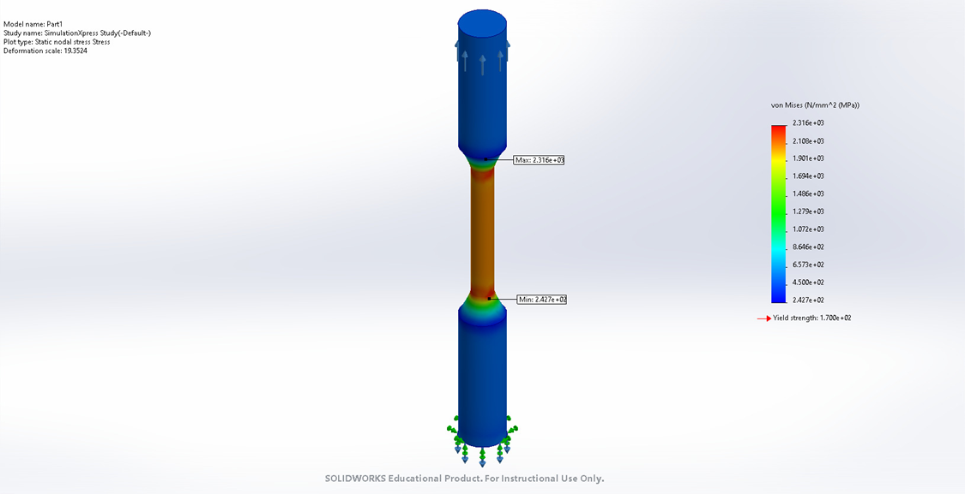
Engineering Calc. Tensile
Figure 18: Flat Test Specimen – Stress Results
Figure 19: Round Test Specimen – Stress Results
Notes:
Overview:
Installing and Troubleshooting a M100LabR Concept Laser PBF Printer
Printing and evaluating parts and specimens (ie Stress-Strain, Thermal Management)
Creation of a user manual and short curriculum for ME286L
Included is the printer itself, powder mixer, powder trolley, and various powdered alloys for use with the printer
Location of set-up: CEIAS IDEA Lab, Room 116A

Slide 12
Commissioning Evaluation
1. Needs Assessment
Requirements
Consultation with Stakeholders
Equipment: Wet-separating vacuum, argon tank holder, PPE, wire EDM/bandsaw, etc.
Software: Magics
Lab: 230V outlet, chemical disposal
Mike Downey: Industry expert and donation involvement.
Dr. Constantin Ciocanel: ME Department Chair and project sponsor
Honeywell and U of A: Industry standards and successful installation
Request for Proposals
Evaluate Proposals
Quotes for equipment
Compare quotes
Contact Finalization
Order equipment and submit work orders
3. Pre-Installation Planning
Site Preparation
Infrastructure Checks
Meet with chemical safety representative in IDEA Lab: ventilation, safety procedures, machine and gas placement, etc.
Install 230V outlet
Ensure safe disposal area
2. Vendor Selection and Procurement
Vendor Research
Equipment
Electrician
GE health check and upgrade
Notes:
Overview:
Installing and Troubleshooting a M100LabR Concept Laser PBF Printer
Printing and evaluating parts and specimens (ie Stress-Strain, Thermal Management)
Creation of a user manual and short curriculum for ME286L
Included is the printer itself, powder mixer, powder trolley, and various powdered alloys for use with the printer
Location of set-up: CEIAS IDEA Lab, Room 116A

Slide 13
Commissioning Process Cont.
4. Installation and Setup
Installation
Software Setup
Manual installation guide
Install Magics on new computer
Ensure existing machine software is operational
Troubleshooting
Machine Repair
Find alignment issues and determine cause
Determine if external technician needed for repair
Fix issue
5. Testing
Without material, then with material
Initial Calibration and Configuration
Built in software configuration and machine calibration
Safety Testing
Test emergency stops, ventilation, etc.
Functional Testing
Starting with small prints
6. Training
User Training
Maintenance Training
First print tutorial with model and full instruction manual: How to slice a model in Magics, upload and use printer software, and run printer.
IDEA Lab employee will need to maintain printer
Notes:
Overview:
Installing and Troubleshooting a M100LabR Concept Laser PBF Printer
Printing and evaluating parts and specimens (ie Stress-Strain, Thermal Management)
Creation of a user manual and short curriculum for ME286L
Included is the printer itself, powder mixer, powder trolley, and various powdered alloys for use with the printer
Location of set-up: CEIAS IDEA Lab, Room 116A

Slide 14
Commissioning Process Cont.
7. Ongoing Maintenance and Support
Regular Maintenance
Maintenance schedule and instructions
Vendor Support
Maintain GE contact for repairs and support
Successful Commissioning:
Fixed and fully operational
Safe
Ready for IDEA Lab training and student work orders
Ready for implementation into ME 286L curriculum
8. Documentation and Handover
Documentation
Ensure manuals and safety documentation are available and easily accessible
Notes:
Overview:
Installing and Troubleshooting a M100LabR Concept Laser PBF Printer
Printing and evaluating parts and specimens (ie Stress-Strain, Thermal Management)
Creation of a user manual and short curriculum for ME286L
Included is the printer itself, powder mixer, powder trolley, and various powdered alloys for use with the printer
Location of set-up: CEIAS IDEA Lab, Room 116A

Slide 15
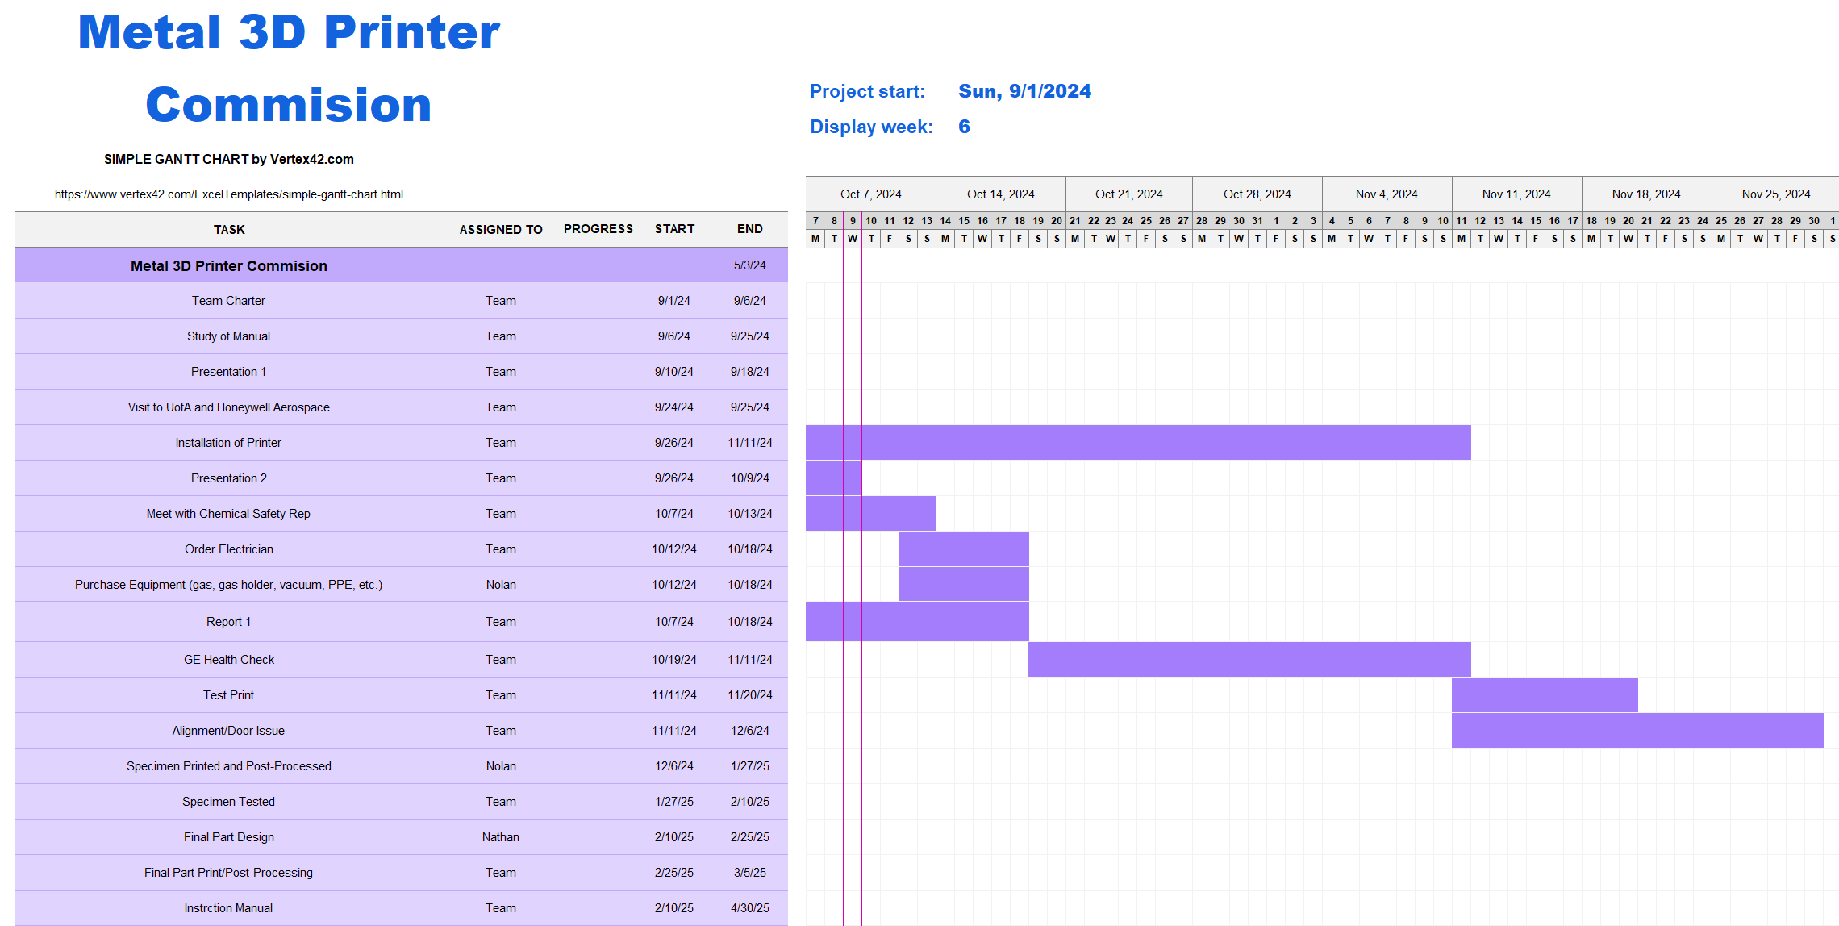
Schedule

Slide 16
Budget
Items needed | Cost of Items ($) | Amount Needed | Total ($)
P3D Respirator | 249.99 | 2 | 499.98
Uline Industrial Nitrile Gloves | 13 | 2 | 26
Dewalt Concealer Safety | 12.24 | 2 | 24.48
ECLIPSE Static Control Wrist Strap | 6.43 | 1 | 6.43
Ruwac Wet Seperator MX200 | 9850 | 1 | 9850
Gas Tank Holder | 69.99 | 1 | 69.99
Class D Fire Extinguisher | 1100 | 1 | 1100
Computer | 1000 | 1 | 1000
Wire EDM | 15000 | 1 | 15000
Electrician Visit | 2000 | 1 | 2000
Potential GE Visit | 5,000 | 1 | 5000
Monthly Maintenance | 50 | 12 | 600
Overall Total ($) |  |  | 35176.88

Slide 17
Thank You!
Any Questions?

